Slide 1
Fungi Kingdom Division Ascomycota Division Basidiomycota Lichens
Laboratory work 5

Slide 2
Material:
Divisions Ascomycota
Class Pyrenomycetes
Order Hypocreales
Objective:
familiarize yourself with the structure of cleistothecia of “powdery mildew”
Tasks of work:
Draw cleistothecia.

Slide 3
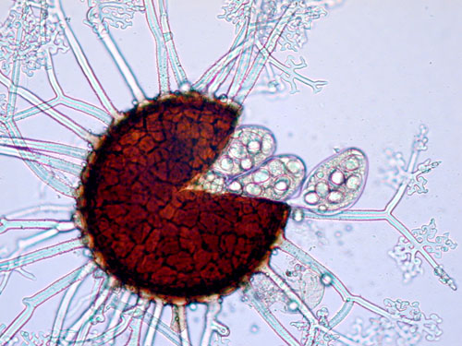
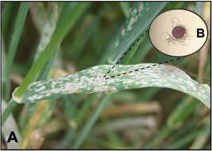
Cleistothecia with appendages ("powdery mildew“).
Obligatory parasites of higher plants, cause the disease - "powdery mildew“. Erysiphales have superficial mycelium which extracts nourishment from the host plant through specialized hyphae that penetrate the epidermal cells of the host by means of absorbing organs called haustoria.
At the end of the growing season, powdery mildew fungi produce sexual spores, known as ascospores, in a sac-like ascus (pl. asci) enclosed in a fruiting body called a chasmothecium (pl. chasmothecia) (cleistothecium is a former term for this structure that is still widely used). The chasmothecium is generally spherical with no natural opening; asci with ascospores are released when a crack develops in the wall of the fruiting body. This type of fruiting body is unique among the Ascomycota. A variety of appendages may occur on the surface of the chasmothecia. These appendages are thought to act like the hooks of Velcro fastener, attaching the fruiting bodies to the host, particularly to the bark of woody plants, where they overwinter.

Slide 4
Material:
Divisions Ascomycota
Class Euascomycetes
Order Hypocreales
Claviceps purpurea
Objective:
study the features of the structure and development of Claviceps purpurea
Tasks of work:
Draw the life cycle of ergot

Slide 5
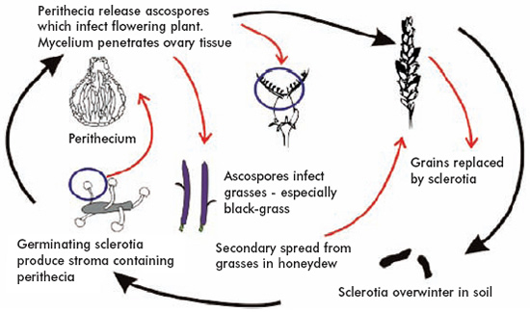
Claviceps purpurea ("rye ergot fungus") grows on rye and related plants, and produces alkaloids that can cause ergotism in humans and other mammals who consume grains contaminated with its fruiting structure (called ergot sclerotium).
A sclerotium plural sclerotia is a compact mass of hardened fungal mycelium containing food reserves. One role of sclerotia is to survive environmental extremes. In some higher fungi such as ergot, sclerotia become detached and remain dormant until favorable growth conditions return.
Life cycle of ergot

Slide 6
Material:
Divisions Ascomycota
Class Discomycetes
Order Pezizales
Morchella conica, Gyromitra esculenta
Objective:
study the features of the structure of Morchella conica and Gyromitra esculenta
Tasks of work:
Draw the appearance of the fruit body of the indicated representatives

Slide 7
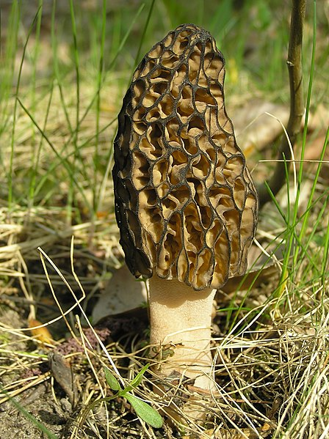
Fruit body of Morchella conica
Morchella, the true morels, is a genus of edible sac fungi closely related to anatomically simpler cup fungi in the order Pezizales (division Ascomycota). These distinctive fungi have a honeycomb appearance due to the network of ridges with pits composing their cap. Morels are prized by gourmet cooks, particularly in French cuisine.

Slide 8
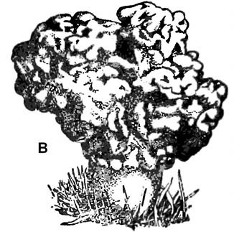
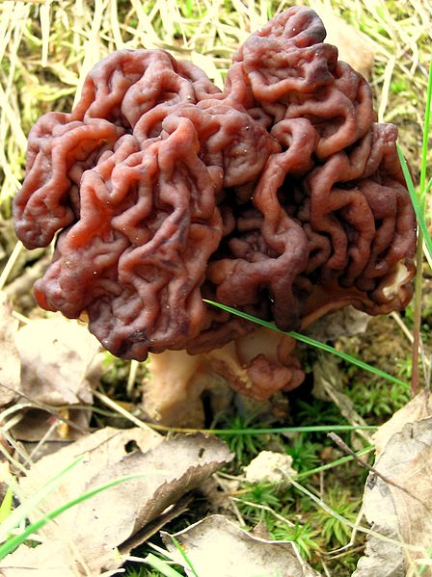
Fruit body of Gyromitra esculenta
Gyromitra esculenta is an ascomycete fungus from the genus Gyromitra, widely distributed across Europe and North America. The fruiting body, or mushroom, is an irregular brain-shaped cap dark brown in colour that can reach 10 cm high and 15 cm wide, perched on a stout white stipe up to 6 cm high.
Although potentially fatal if eaten raw, Gyromitra esculenta is a popular delicacy in Scandinavia, Eastern Europe, and the upper Great Lakes region of North America.

Slide 9
Material:
Divisions Basidiomycota
Class Holobasidiomycetes
Order Agaricales
Agaricus bisporus.
Agaricus bisporus is an edible basidiomycete mushroom native to grasslands in Europe and North America. It has two color states while immature—white and brown—both of which have various names. When mature, it is known as portobello mushroom. When immature and white, this mushroom may be known as common mushroom, button mushroom, cultivated mushroom, table mushroom, crimini mushroom and champignon mushroom.
Objective:
study the features of the structure of Agaricus bisporus.
Tasks of work:
Cut a mushroom to reveal the gills. Basidia and basidiospores form on the gills. View a cross section of the cap of a mushroom. Draw the appearance of the fruit body of the Agaricus bisporus and basidia and basidiospores on the gills.

Slide 10
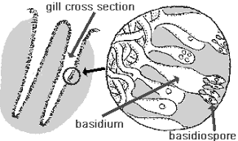
Basidia and basidiospores on the gills

Slide 11
Material:
Divisions Basidiomycota
Class Teliobasidiomycetcetes
Order Uredinales
Puccinia graminis (stem rust) .
Objective:
Study the morphology of stem rust (Puccinia graminis).
Tasks of work:
Draw the appearance of the affected plants, the location of the sporophores of the fungus on it.
Draw the life cycle of Puccinia graminis.

Slide 12
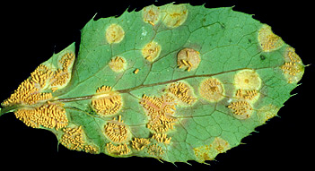
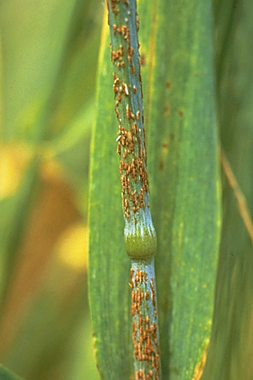
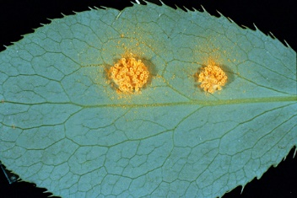
Powdery aeciospores on the lower leaf surface
Pycniospores in a sticky honeydew
The aecial cups are yellow and sometimes elongate to extend up to 5 mm from the leaf surface
Uredinia of Puccinia graminis

Slide 13
The stem, black, and cereal rusts are caused by the fungus Puccinia graminis and are a significant disease affecting cereal crops. Crop species that are affected by the disease include bread wheat, durum wheat, barley and triticale. Different from most fungi, the rust variations have five spore stages and alternate between two hosts. Wheat is the primary host, and barberry is the alternate host.
In Puccinia graminis (Wheat Rust), the species that will be used as the representative for this order, there are five spore stages that are produced and two hosts are required in the completion of the life cycle. The five stages produced are:
Stage 0:Spermagonium
Stage I: Aecium
Stage II: Uredium
Stage III: Telium
Stage IV: Basidium

Slide 14
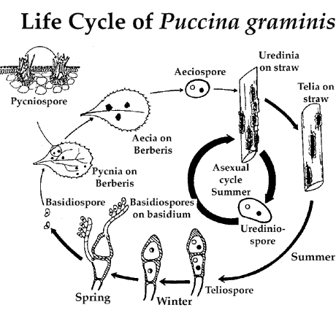

Slide 15
Material:
live specimens of the lichens
Objective:
Study the lichen thallus and its cross-section.
Tasks of work:
Draw the different appearance of the lichen thallus, cross-section of lichen thallus and denote its parts.

Slide 16
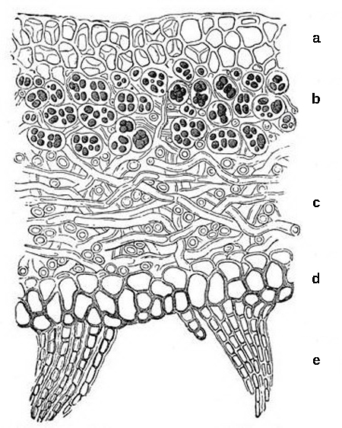
upper cortex of fungal hyphae, which provides protection;
algal zone where photosynthesis occurs
medulla of fungal hyphae,
lower cortex, which also provides protection
rhizines to anchor the thallus to the substrate
Thallus of lichen: This cross-section of a lichen thallus

Slide 17
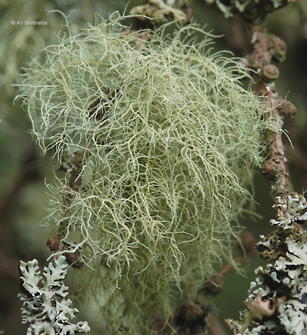
Squamulose lichens
Shrublike appearance (fruticose)

Slide 18
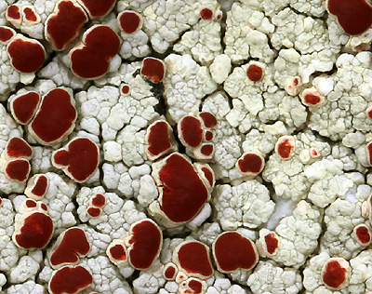
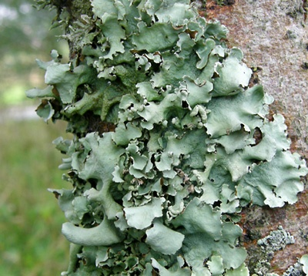
Crust-like appearance (crustose)
Leaflike (foliose) appearance

